Slide 1
CEMA Health System
A Modern Healthcare Management Solution

Slide 2
Agenda
1. Project Overview
2. Key Features
3. Technical Architecture
4. Dashboard & Analytics
5. Security & Compliance
6. Testing & Quality Assurance
7. Deployment & Scalability
8. Future Roadmap

Slide 3
Project Overview
• Django-based healthcare management system
• Designed for managing clients and health programs
• Modern, scalable architecture
• Containerized deployment
• RESTful API design

Slide 4
Key Features
• Comprehensive client management
• Program enrollment tracking
• Real-time analytics dashboard
• Audit logging system
• Multi-language support
• Responsive web interface
• Secure authentication

Slide 5
Technical Architecture
Backend Stack:
- Django 4.2.5
- Django REST Framework
- PostgreSQL
- Redis
- Celery
Frontend Stack:
- HTML5/CSS3
- JavaScript
- Bootstrap
- DataTables
- ApexCharts

Slide 6
Dashboard & Analytics
Key Metrics:
- Client statistics
- Program enrollment rates
- Gender distribution
- Success rates
- Dropout analysis
- Active programs
Visualization:
- Interactive charts
- Real-time updates
- Custom reports
- Export capabilities

Slide 7
Security & Compliance
• JWT authentication
• CSRF protection
• Rate limiting
• Input validation
• Audit logging
• Environment-based configuration
• Secure data handling

Slide 8
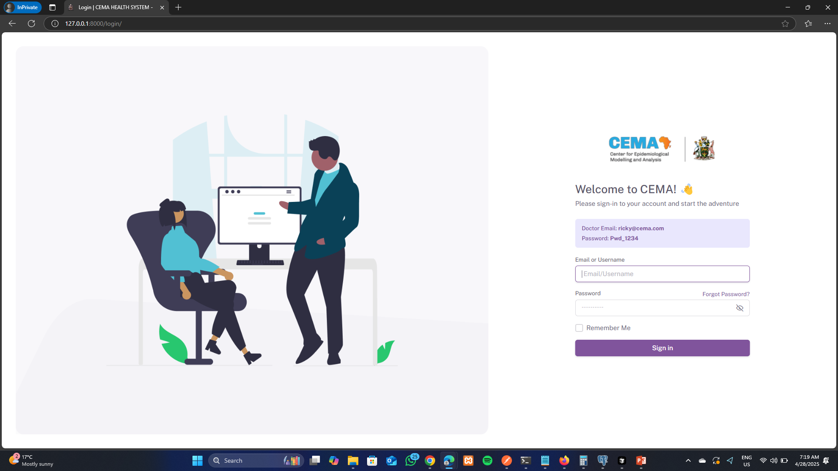
Design
Login page

Slide 9
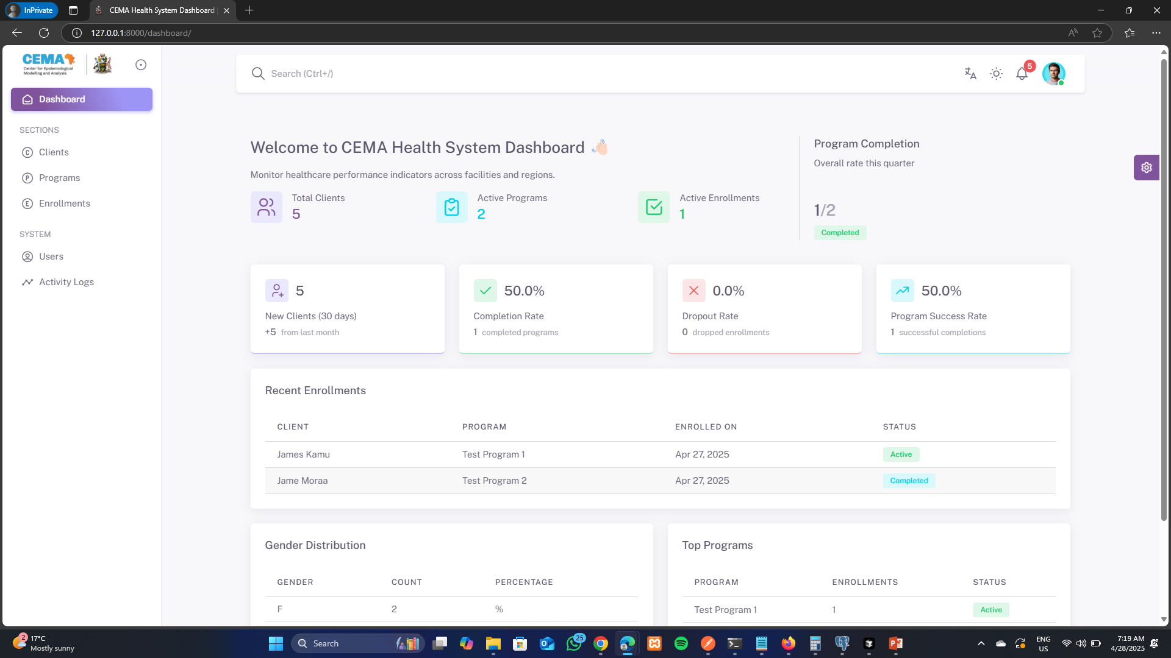
Design
Doctor Dashboard page

Slide 10
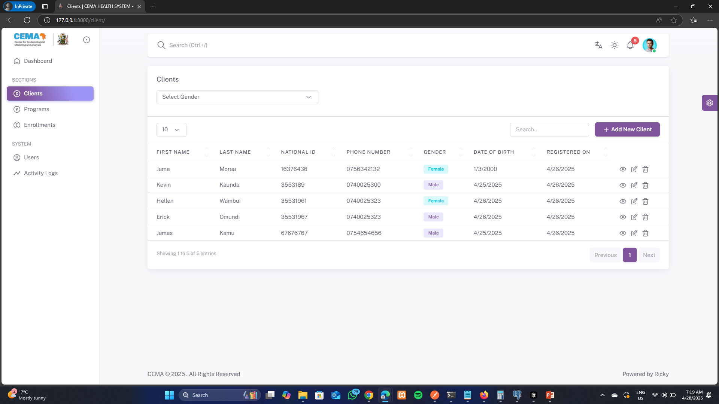
Design
Clients Module

Slide 11
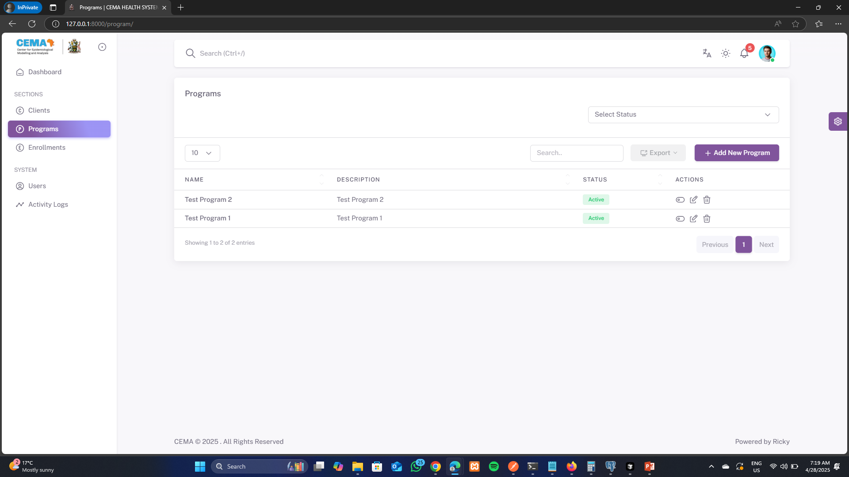
Design
Programs Module

Slide 12
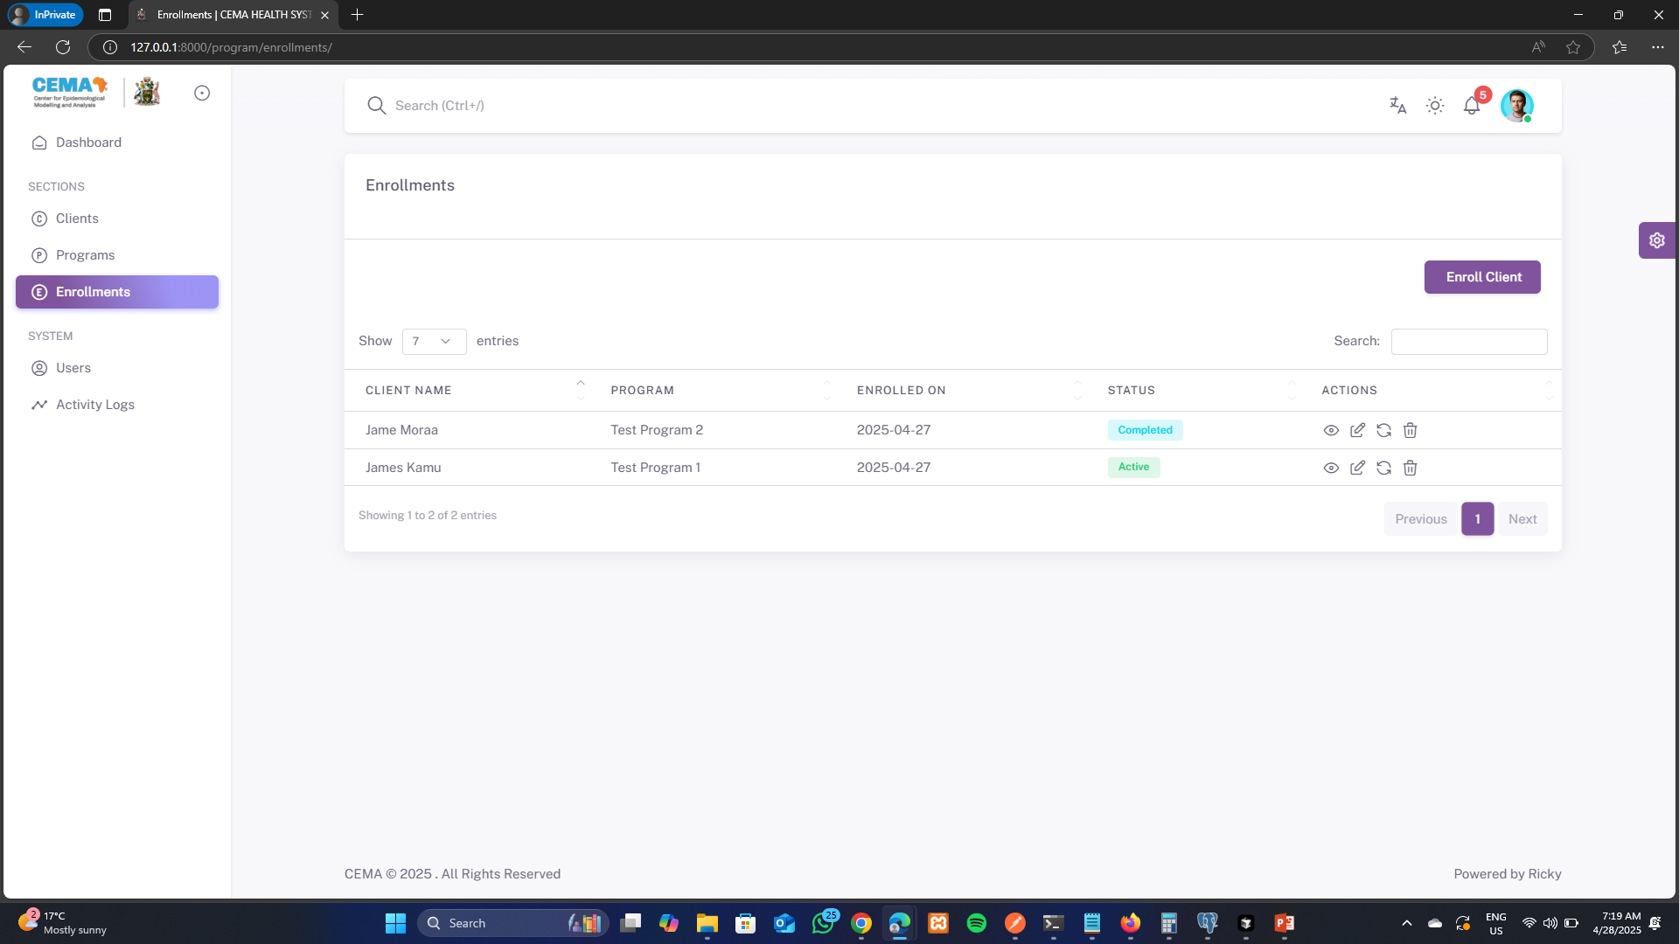
Design
Program Enrollment Module

Slide 13
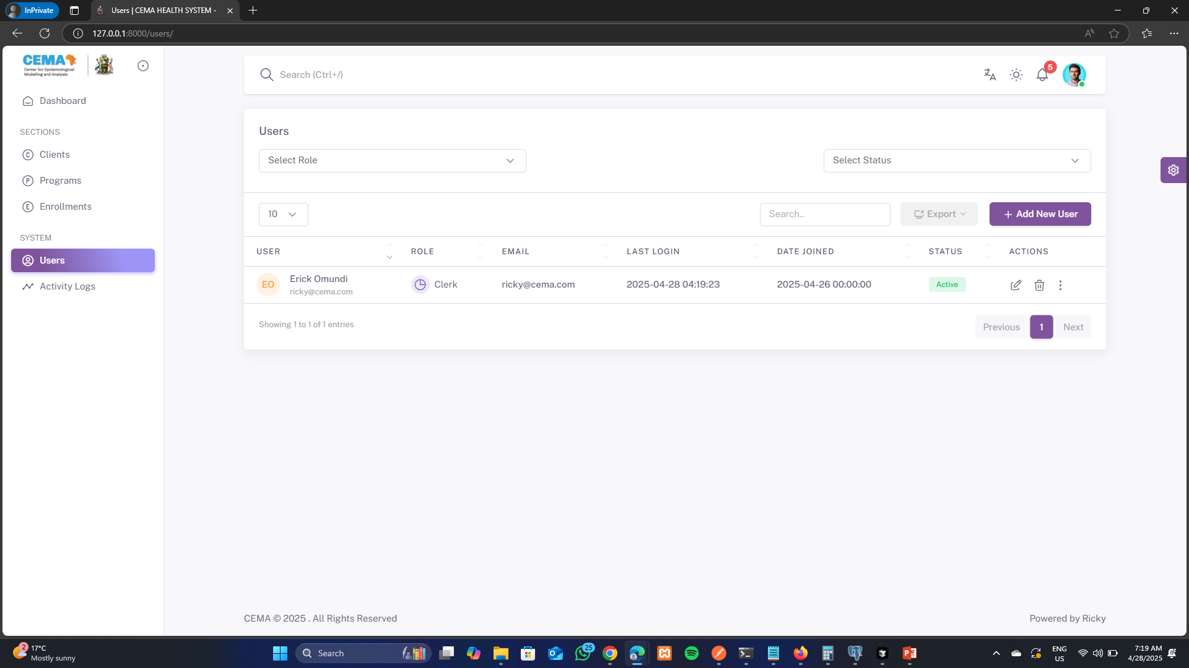
Design
System Users Module

Slide 14
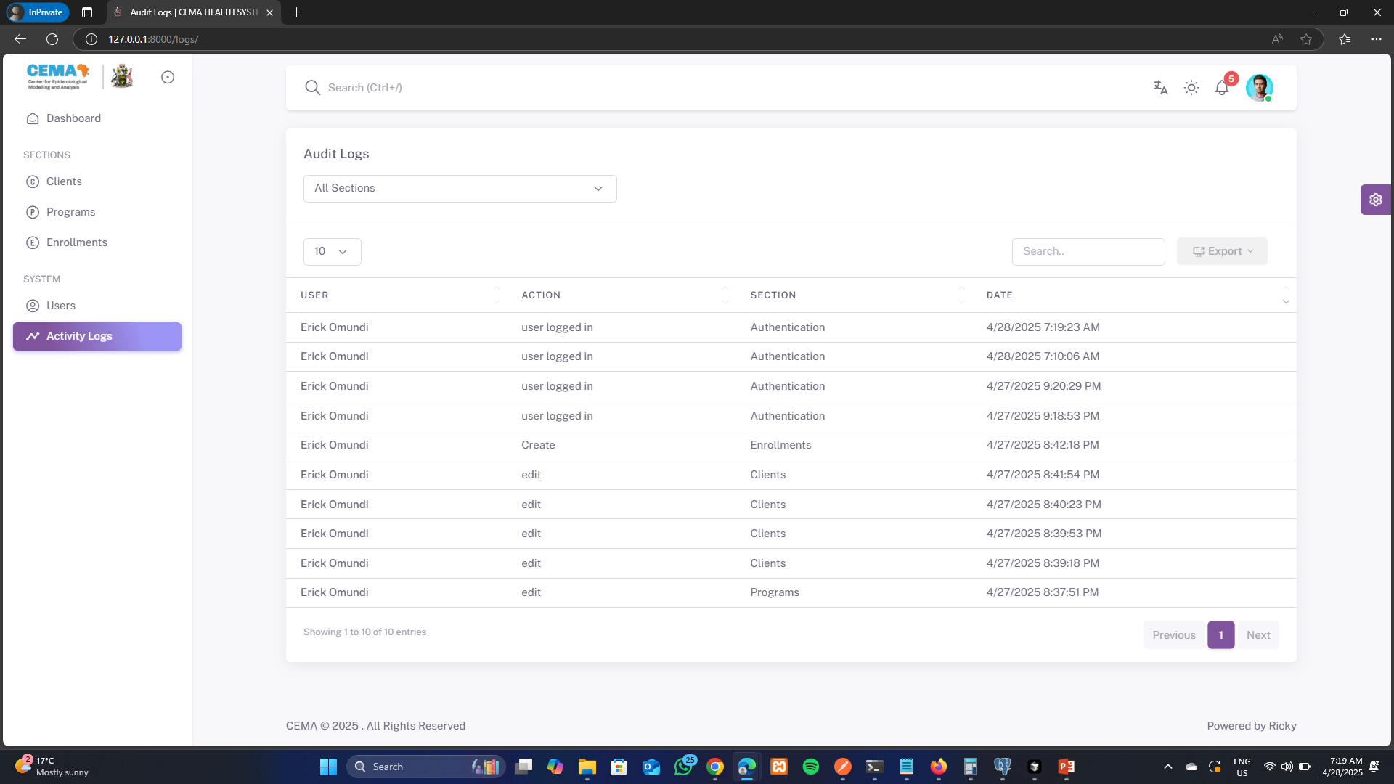
Design
Activities Logs Module

Slide 15
Testing & Quality Assurance
Test Coverage:
- API endpoints
- User authentication
- Client management
- Program management
- Enrollment tracking
- Dashboard statistics
Testing Tools:
- Django Test Framework
- Coverage reporting
- Automated testing
- CI/CD integration

Slide 16
Deployment & Scalability
Development:
- Local development setup
- Virtual environment
- Debug mode
Production:
- Docker containers
- Nginx reverse proxy
- Gunicorn application server
- PostgreSQL database
- Redis caching
- Celery task queue
Deployment Link - https://cema.kaiscab.com/

Slide 17
Future Roadmap
Planned Features:
- Mobile application
- Advanced analytics
- AI-powered insights
- Integration with health devices
- Telemedicine capabilities
- Enhanced reporting
Technical Improvements:
- Performance optimization
- Microservices architecture
- Enhanced security features
- Advanced caching
- Real-time updates

Slide 18
Thank You
Questions?
Contact: + 254740025323
Repository: https://github.com/rickxy/cema-health-system.git
Deployment Link - https://cema.kaiscab.com/

